Slide 1


Engineering Codex
Tech Scanner

Slide 2
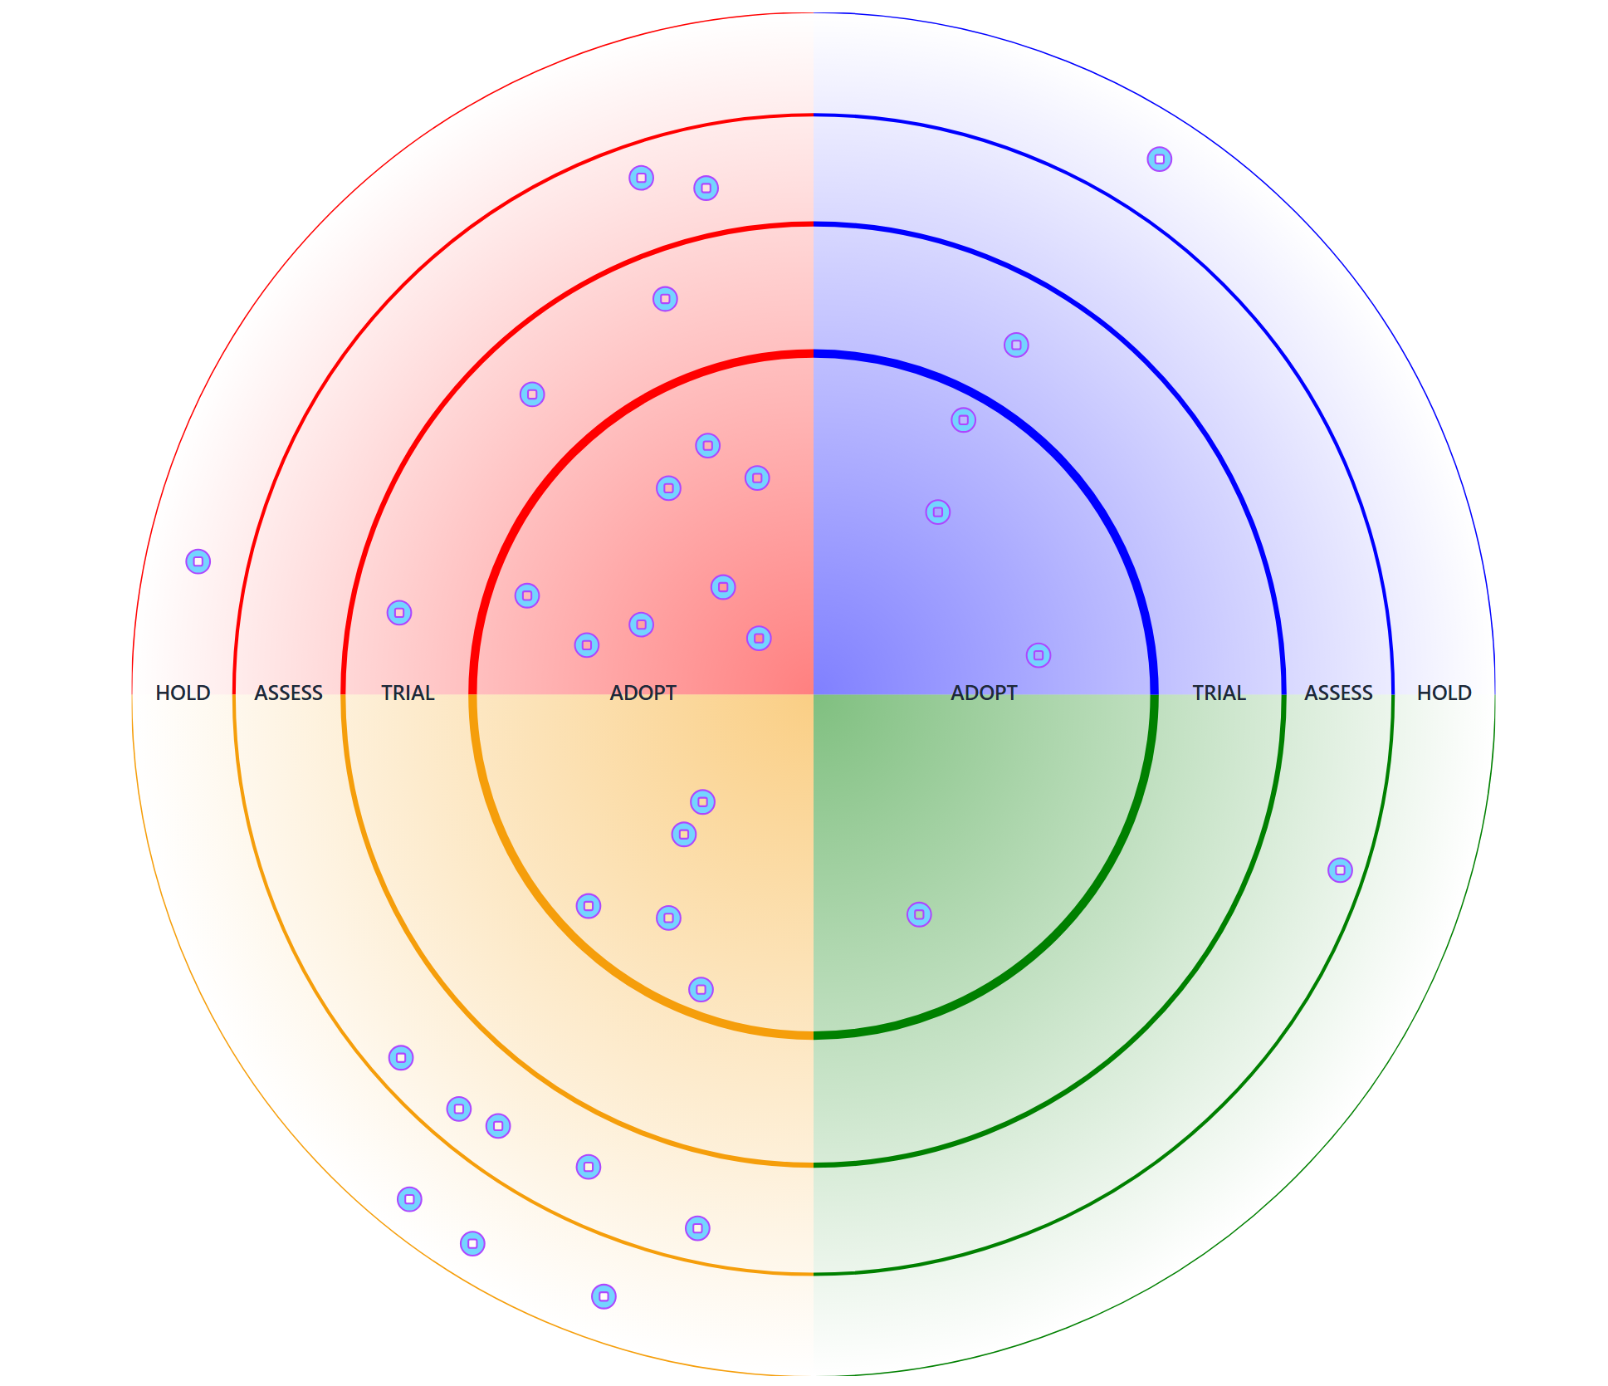
GDX Tech Scanner
Our Tech Scanner gives GDX a shared, opinionated view of which technologies we should: Adopt, Trial, Assess, or Hold.
It represents a shared, evolving view of our technology landscape.
track_changes
Guides consistent, strategic tech choices
view_quilt
Helps reduce fragmentation and duplication
update
Is continuously updated with org-wide input

Slide 3
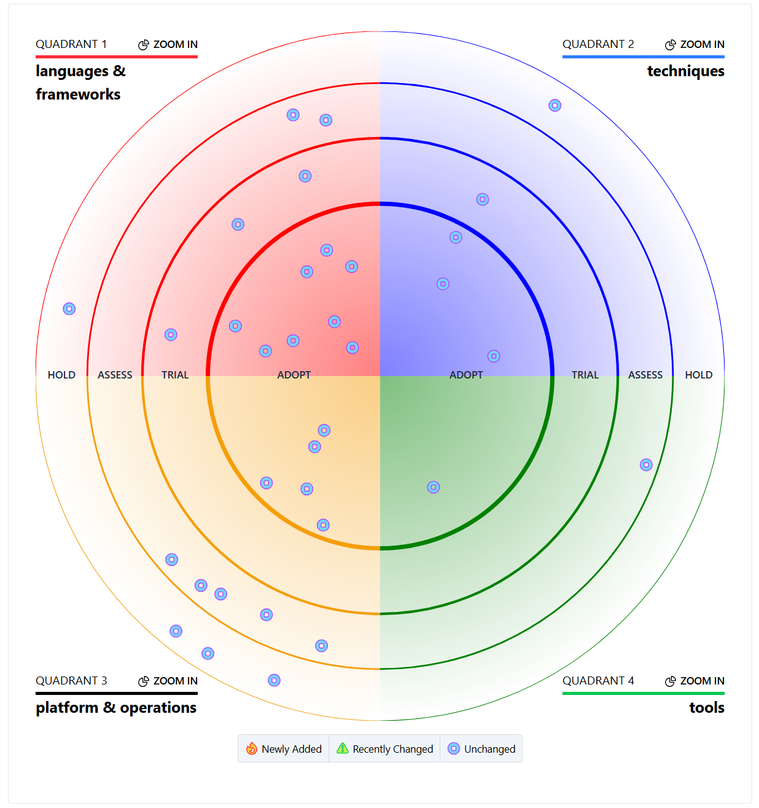
What Is The Tech Scanner?
explore
Opinionated Guidance
Strategic direction, not just a list of tools.
layers
Quadrants & Rings
Structured by Adopt, Trial, Assess, and Hold.
trending_up
GDX Tech Vision
Reflects the long-term technical goals of GDX.
published_with_changes
Adaptive Evolution
Evolves with our strategy and capabilities.

Slide 4
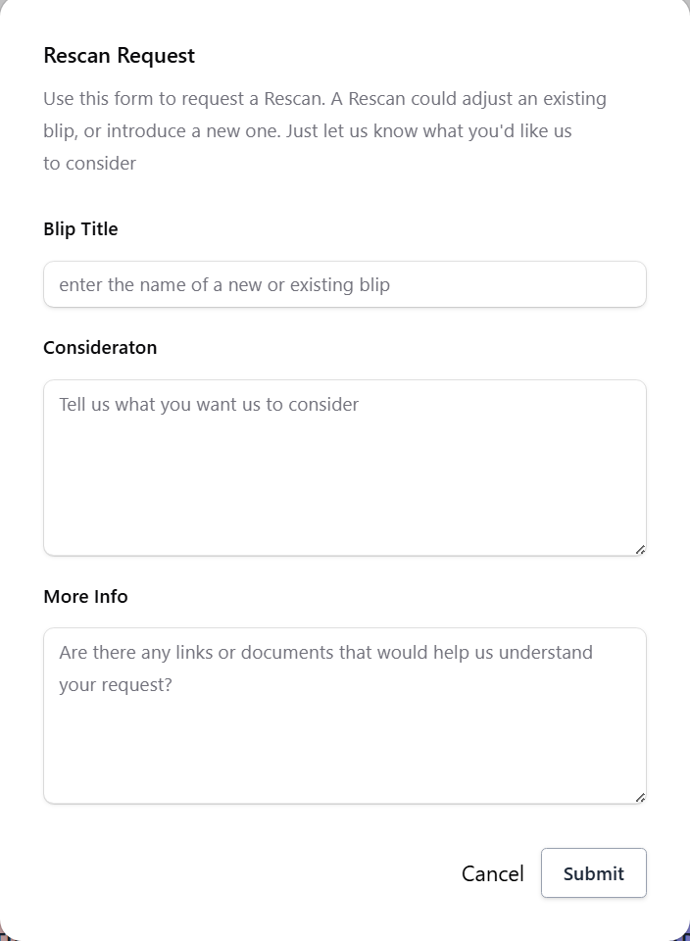
Continuous Contributions
add_circle_outline
Submit Anytime
Anyone in GDX can submit a change request at any time.
description
Rescan Request Form
Use the standard form to kick off your contribution.
code
GitHub Issues
Each submission is tracked as a GitHub issue.
speed
Weekly Triage
Tech Leads review weekly to maintain momentum.
quarterly review ≠ quarterly input

Slide 5
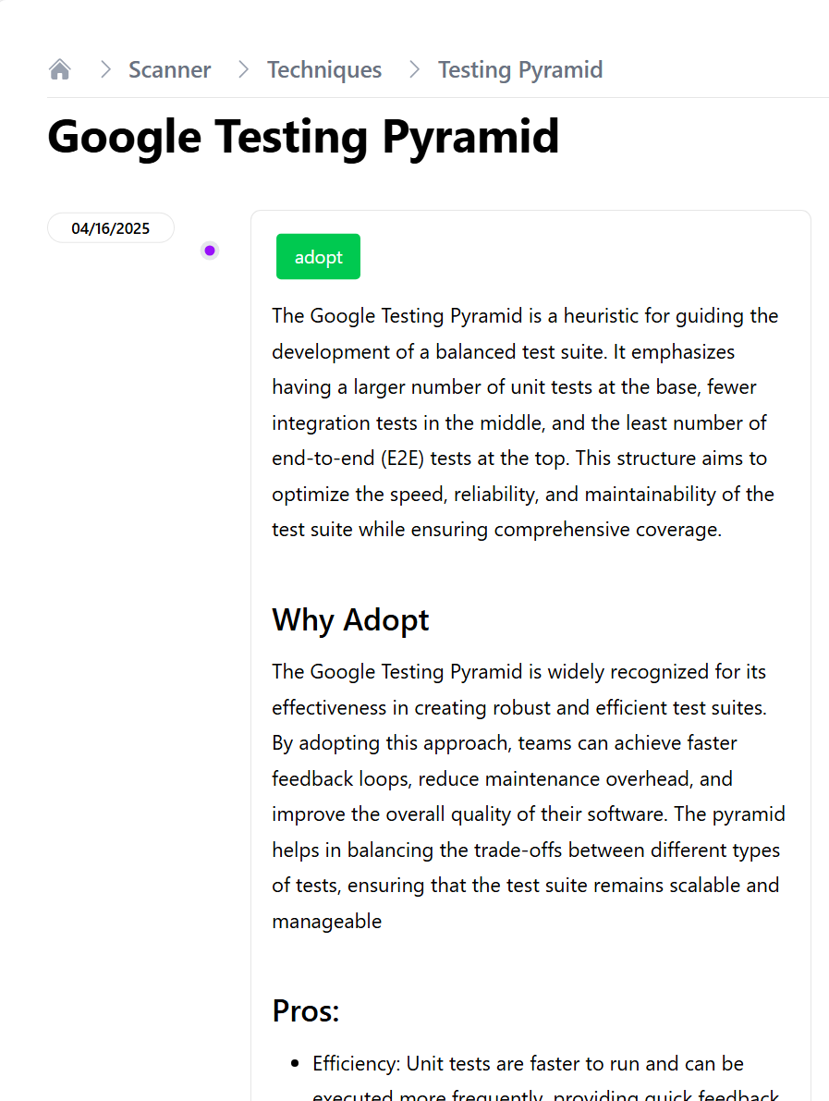
How the Workflow Operates
description
1. Form Submission
Submit via the Rescan Request form
code
2. Issue Creation
GitHub issue created automatically
speed
3. Weekly Triage
Tech Leads triage weekly
groups
4. Leadership Review
Leadership reviews quarterly
update
5. Radar Update
Radar updated continuously

Slide 6
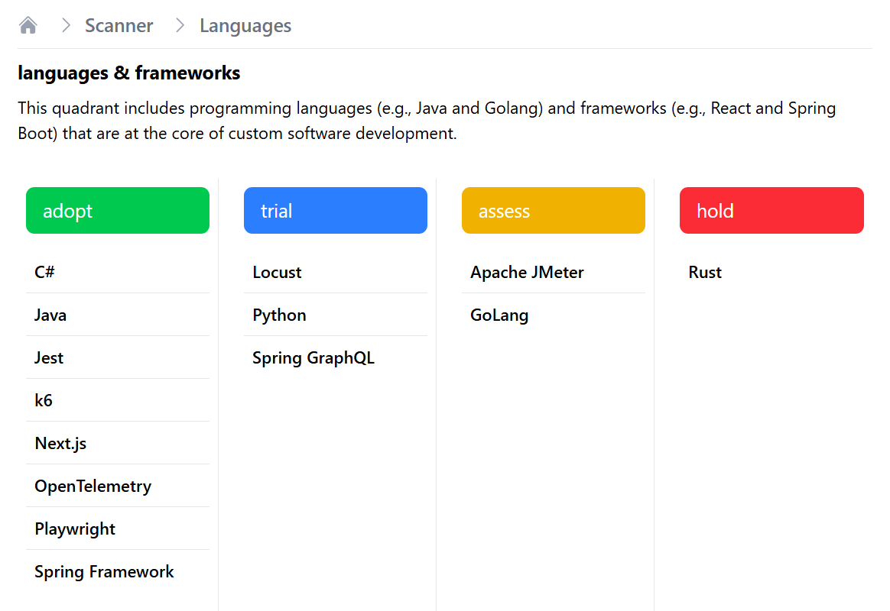
Quarterly Leadership Review
Strategic checkpoint, not a bottleneck
list_alt
Issue Resolution & Unblocking
Focus on resolving bottlenecks and unblocking teams from the submission pipeline
thumbs_up_down
Approve Ring Changes
Decision on major changes (Adopt / Hold)
verified
Strategic Alignment Across Teams
Ensuring all engineering efforts are unified with the GDX technical strategy
publish
Radar Updates
Publish quarterly radar update + summary

Slide 7
What This Means for GDX
groups
Continuous Contribution
Teams contribute discoveries in real-time.
Engineering Impact
map
"Paved Paths" vs. "Road Less Traveled"
Identifying supported solutions to accelerate delivery, while providing visibility for emerging explorations, or retired technologies that require oversight.
verified
Strategic Alignment
Quarterly leadership reviews ensure unity.
radar
Actionable Intelligence
Radar remains current and relevant.
speed
Accelerated Decisions
Visibility reduces sprawl and speeds execution.

